Slide 1
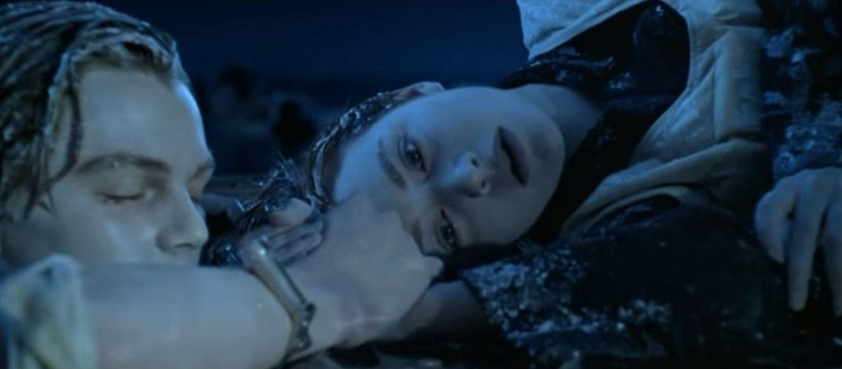
Who survived the sinking of the Titanic ?
Artificial Intelligence
Alexander, Dennis, Hélène

Slide 2
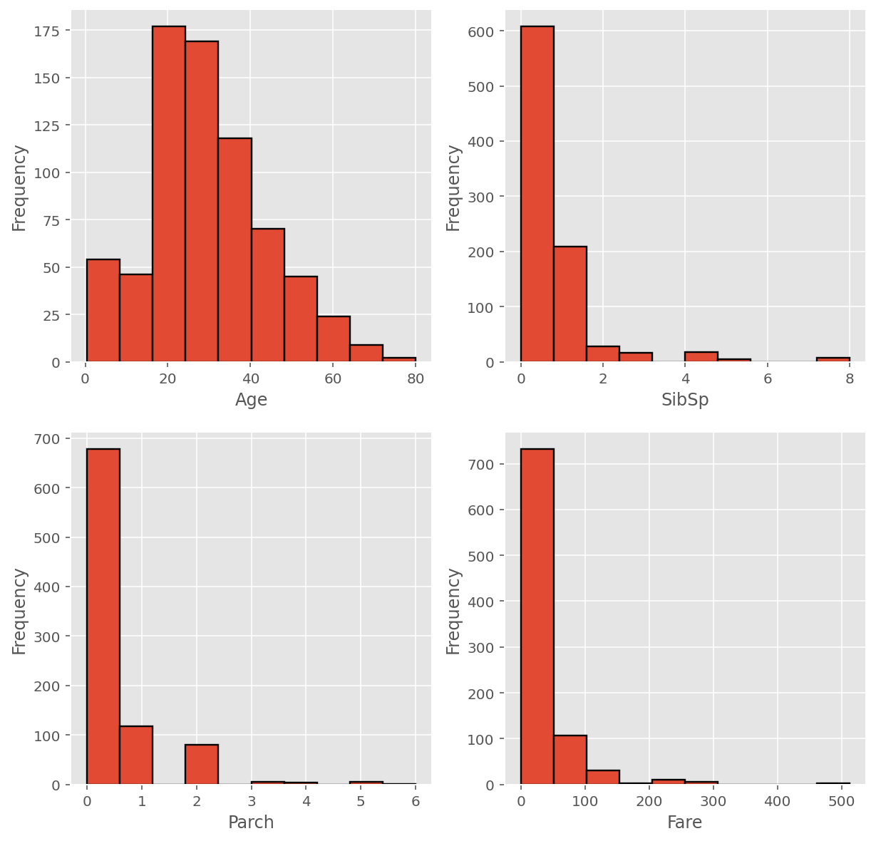
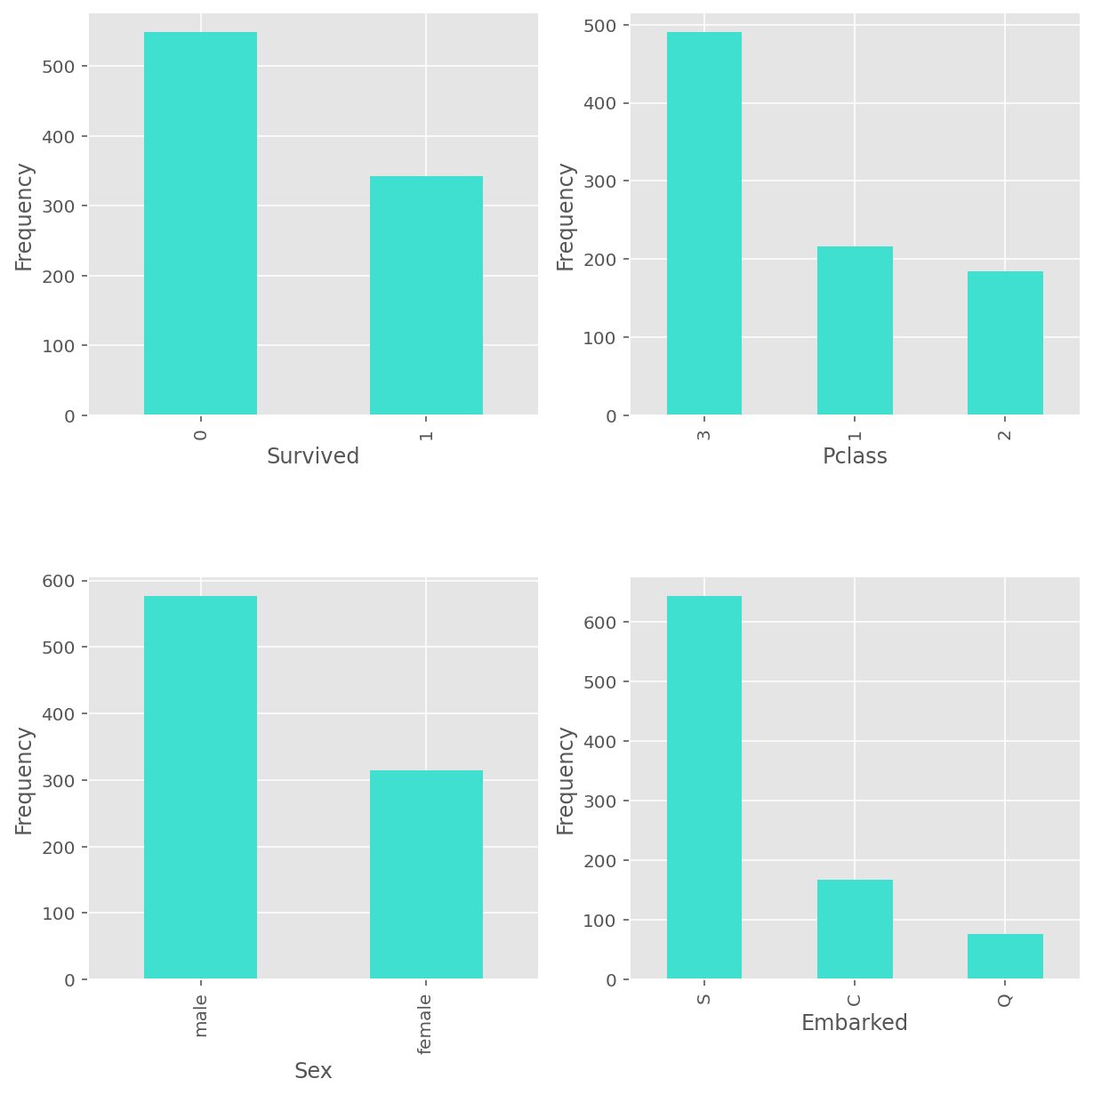
Basic exploration I
Numerical data
Categorical data

Slide 3
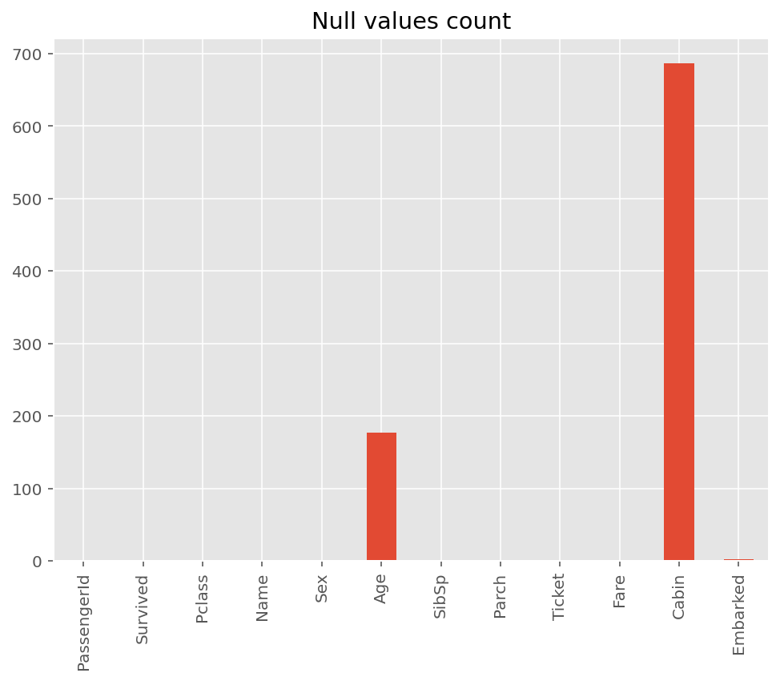
Basic exploration II

Slide 4
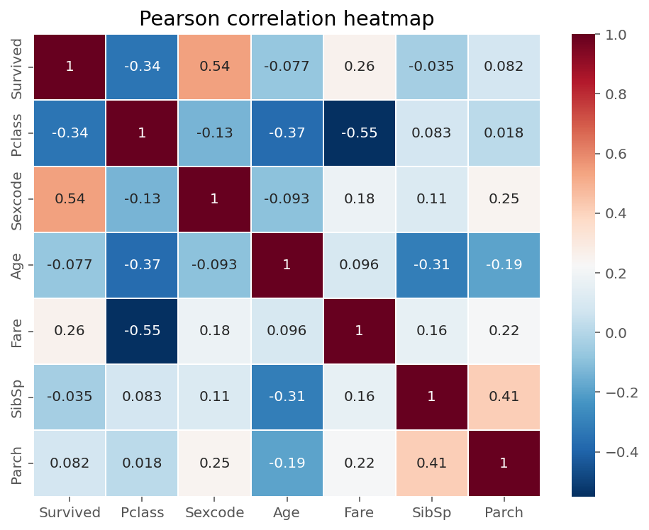
Preliminary analysis
2 main leads:
Sex variable was encoded and it is apparent that a person’s gender plays an important part on whether they survive or not
Obvious negative correlation between “Pclass” and “Survived”: the higher the class, the less chances to survive

Slide 5
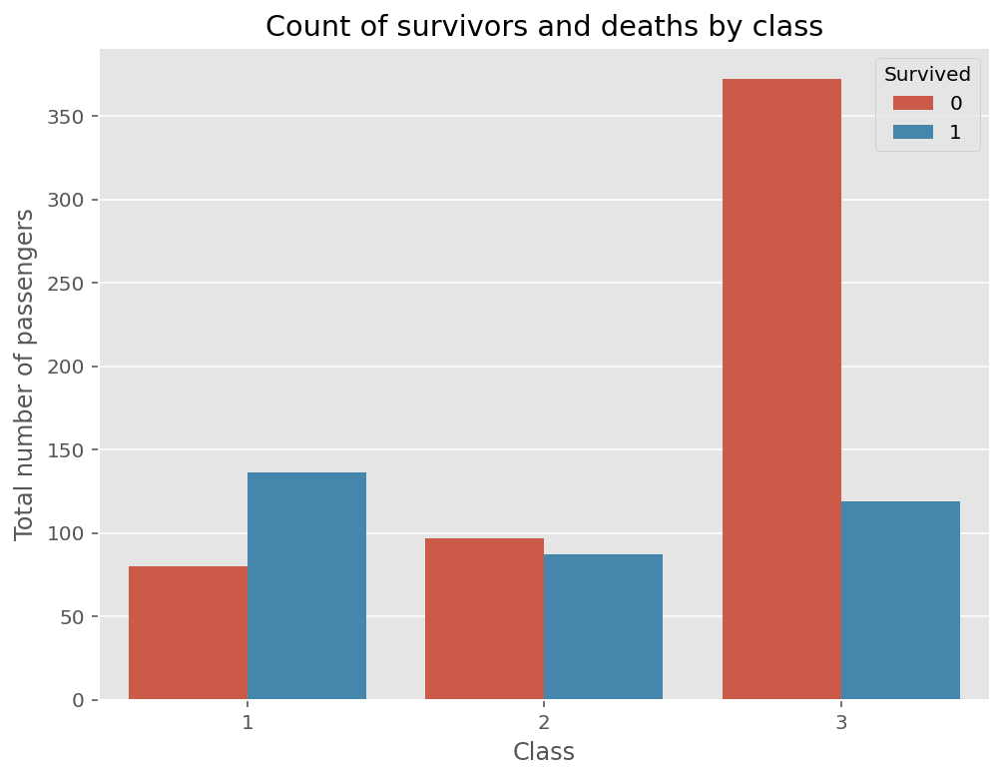
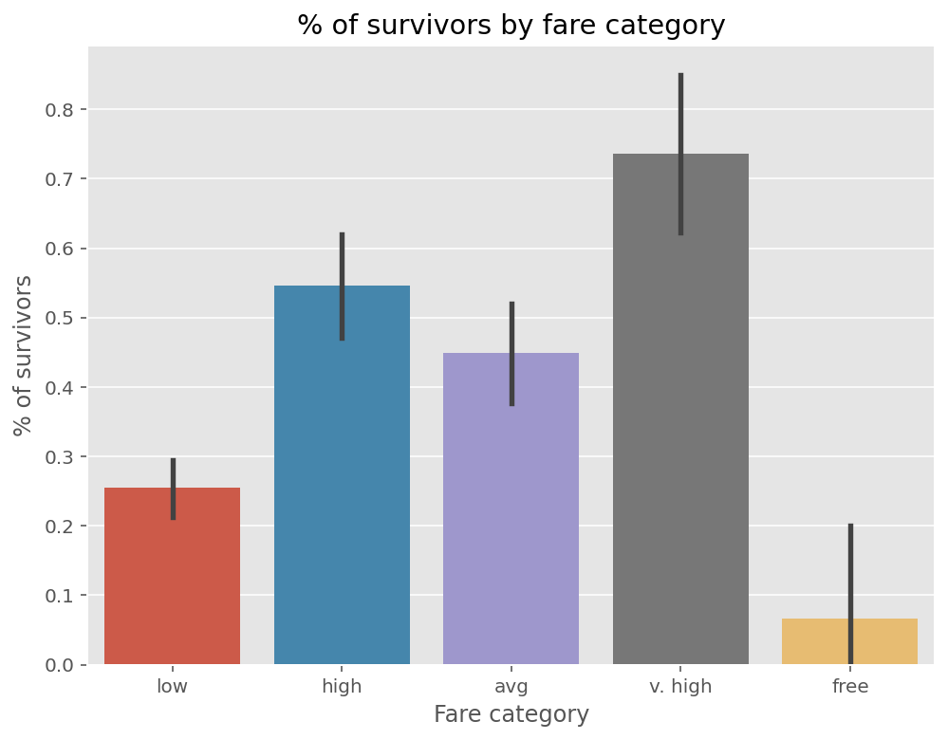
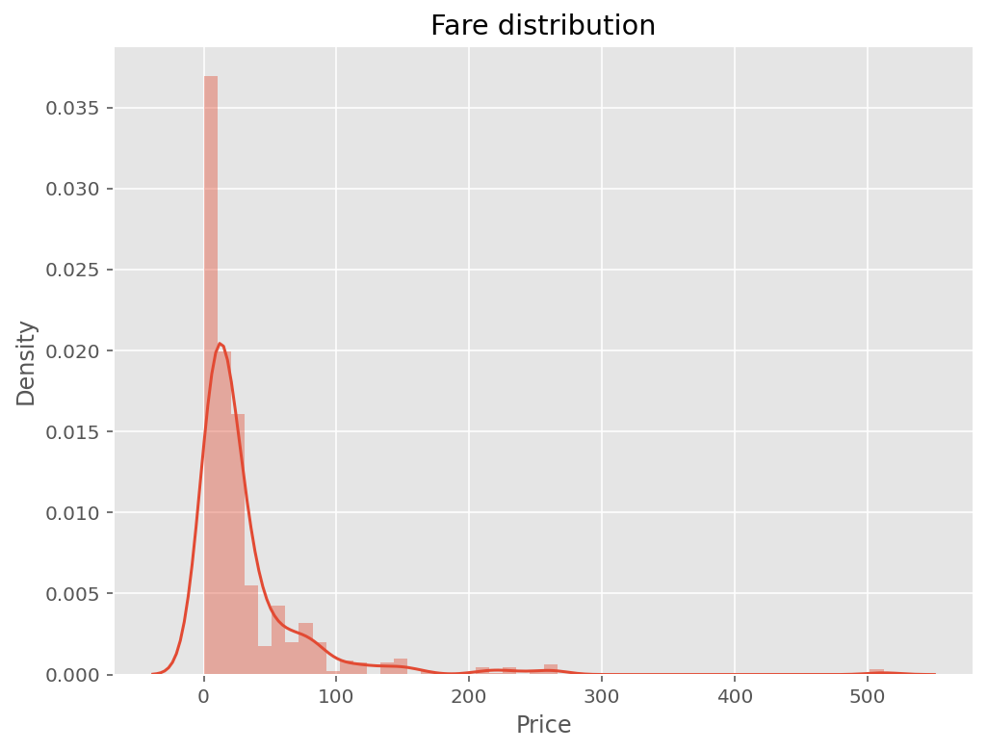
Get rich or die trying
Confirmation that a 3rd class ticket is a curse: only ~¼ survived, versus more than half for 1st class
After observing fare distribution, creation of categories for the different fare amounts :
free, low (under 15), avg (between 16 and 30), high (between 31 and 100) and v. high (above 100)
Likelihood to survive increases with price paid.

Slide 6
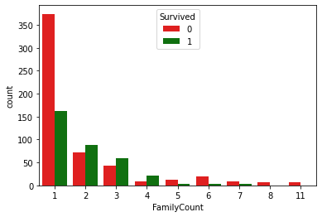
Traveling alone vs with relatives
People traveling with family on the Titanic have more chances to survive
People traveling alone are more likely not to survive

Slide 7
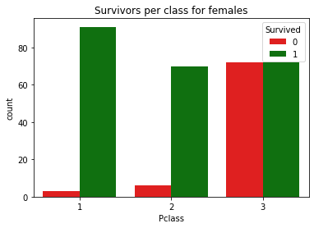
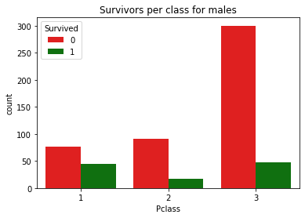
Number of female survivors by class
In this graph, the difference between survivors and non-survivors is very clear. It can be seen that being a woman and being in a preferential class are important variables for survival.

